Slide 1
Is there a relationship between Education and Violence?
Daniela Schloeter
Individual project 2
Prof. Nima Zahadat

Slide 2
Datasets:
World Bank= Intentional homicides by 100 000 people, Primary Gross enrollment, Continent and Country codes.
OECD= PISA scores Reading, Math and Science.
Problems with dataset:
Selection of countries
Selection of years
Missing values
Type of variables
Worldwide -> America
2001-2015 (Less missing values)
Deciding & Preparing

Slide 3
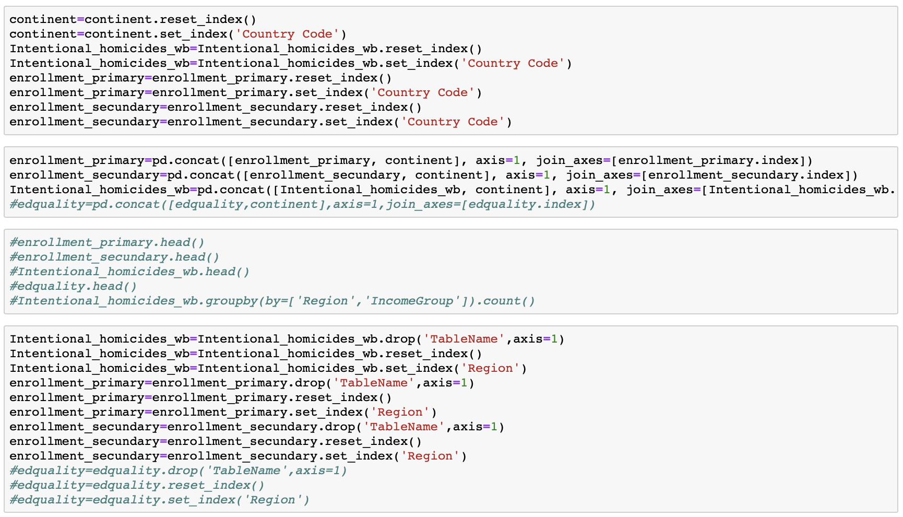
Code - Overview

Slide 4
Introduction
Exploratory plots
Intentional homicides vs. Primary enrollment
Intentional homicides vs. PISA scores
Conclusions and recommendations
Overview
Homicides vs. Enrollment
Homicides vs. PISA scores
Conclusions

Slide 5
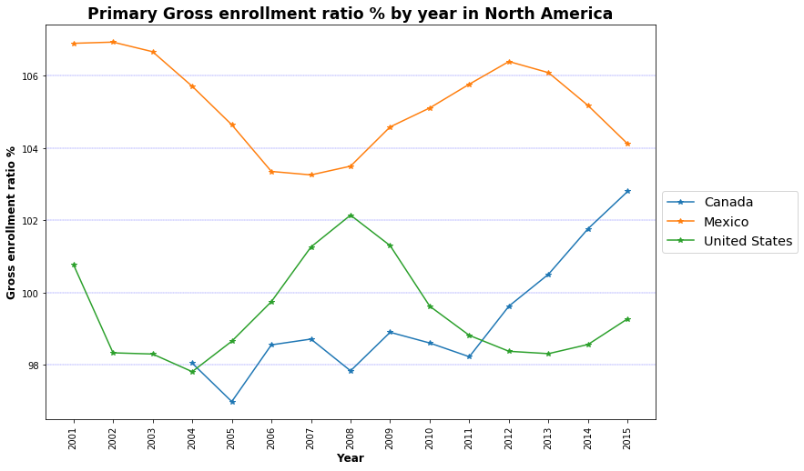
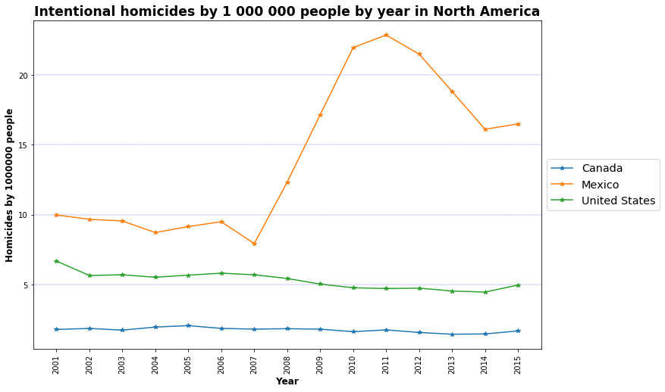
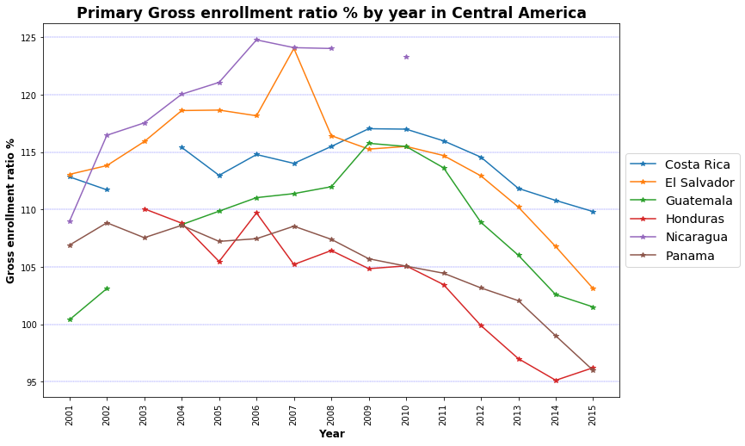
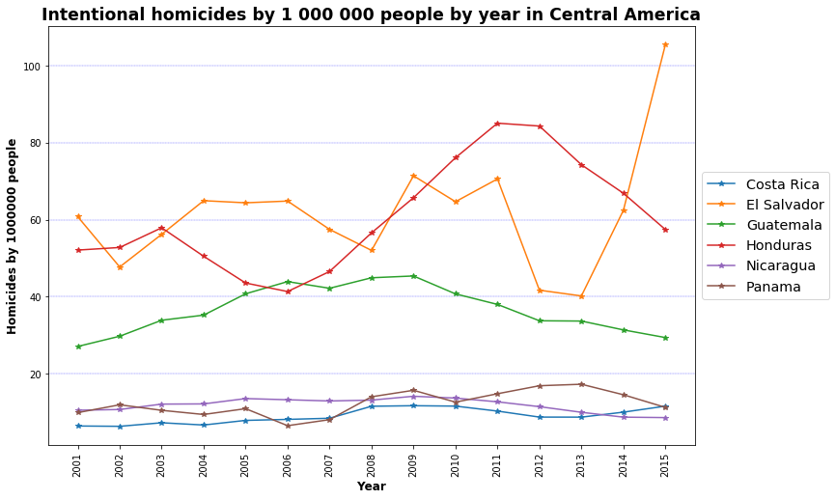
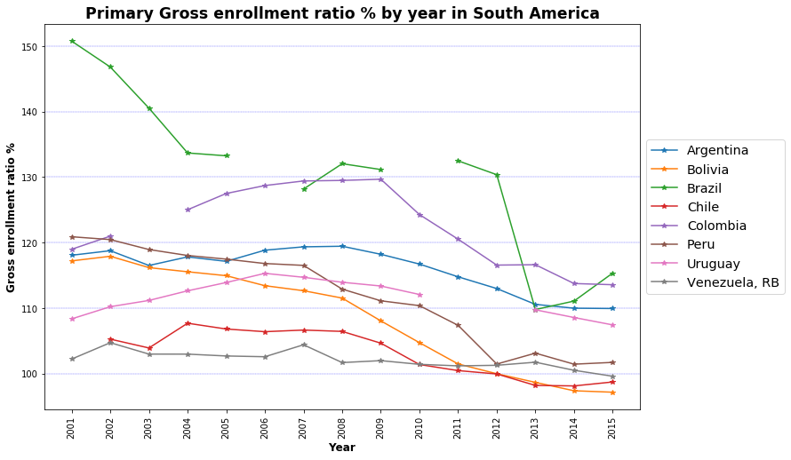
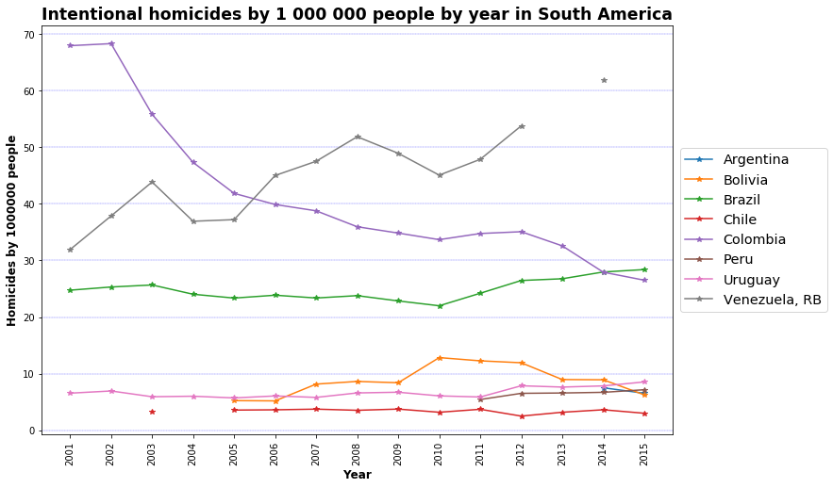
North America
Central America
South America
Overview
Homicides vs. Enrollment
Homicides vs. PISA scores
Conclusions

Slide 6
Variations and Meaningful relationships
Primary enrollment & Intentional homicides
Complete relationships: 196
Complete meaningful relationships: 95
23% of missing relationships
48% meaningful relationships
Overview
Homicides vs. Enrollment
Homicides vs. PISA scores
Conclusions

Slide 7
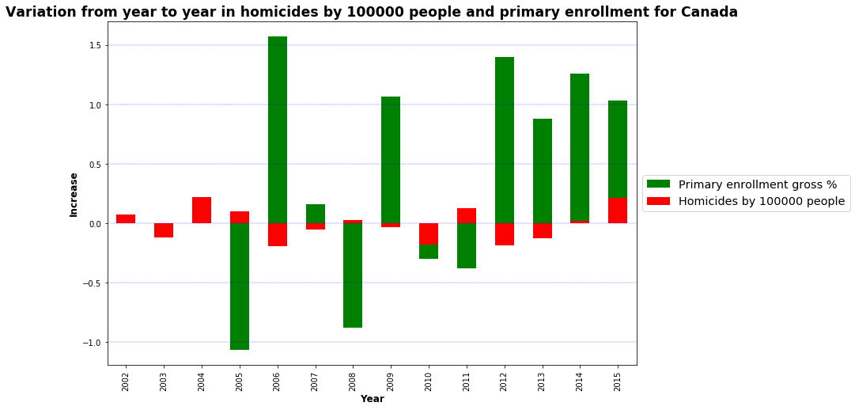
Relationships-North America
50% meaningful relationships
Missing relationships 7%
Meaningful relationships:
Canada 75%
USA 40% - Mexico 40%
Missing relationships:
Canada 20%
USA 0% - Mexico 0%
Overview
Homicides vs. Enrollment
Homicides vs. PISA scores
Conclusions

Slide 8
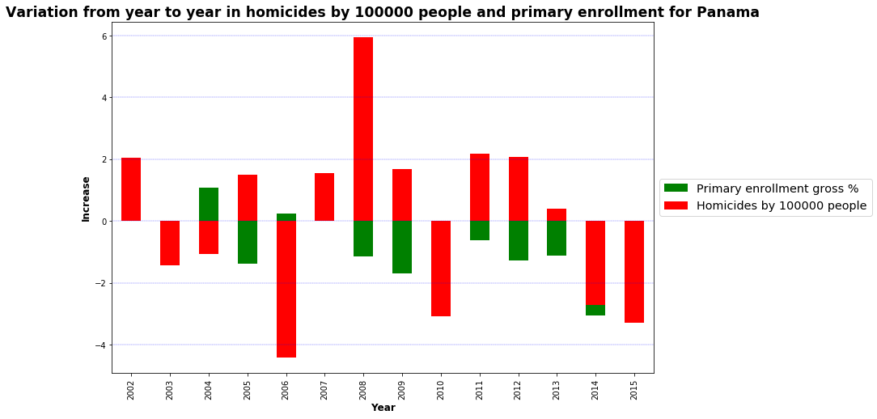
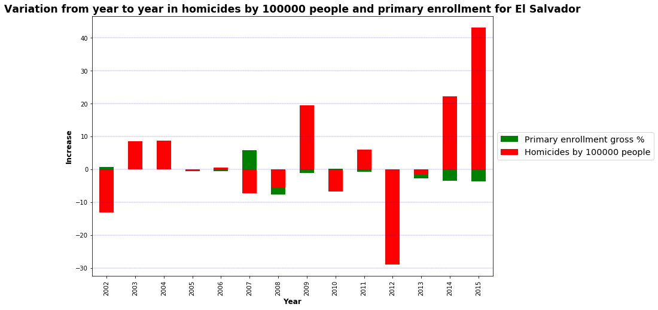
Relationships- Central America
42% meaningful relationships
Missing relationships 14%
Meaningful relationships:
El Salvador 60% - Panama 60%
Honduras 46%
Costa Rica 39%
Nicaragua 25%
Guatemala 8%
Missing relationships:
El Salvador 0% - Panama 0%
Honduras 13%
Costa Rica 13%
Nicaragua 47%
Guatemala 13%
Overview
Homicides vs. Enrollment
Homicides vs. PISA scores
Conclusions

Slide 9
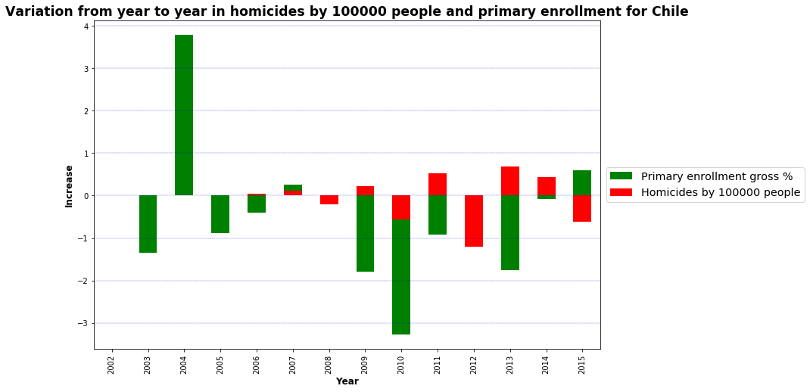
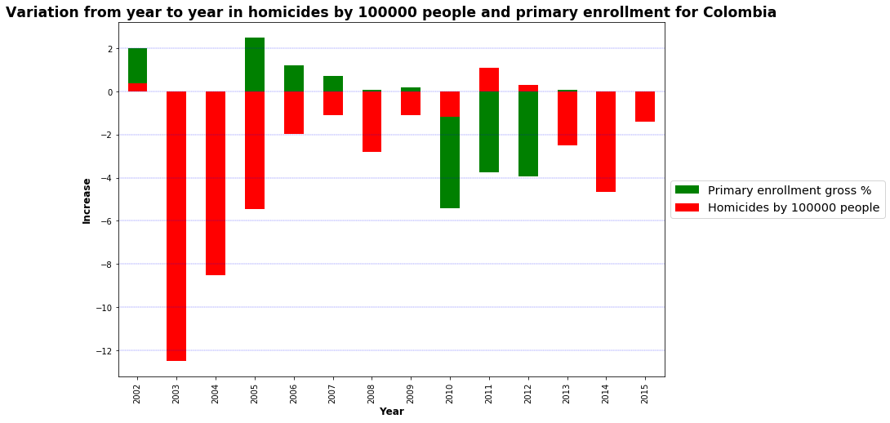
Relationships- South America
55% meaningful relationships
Missing relationships 7%
Meaningful relationships:
Chile 64%
Colombia 62%
Peru 60%
Uruguay 58% - Venezuela 58%
Argentina 50%
Brazil 46%
Bolivia 36%
Missing relationships:
Chile 27%
Colombia 13%
Peru 67%
Uruguay 20% - Venezuela 20%
Argentina 87%
Brazil 27%
Bolivia 27%
Overview
Homicides vs. Enrollment
Homicides vs. PISA scores
Conclusions

Slide 10
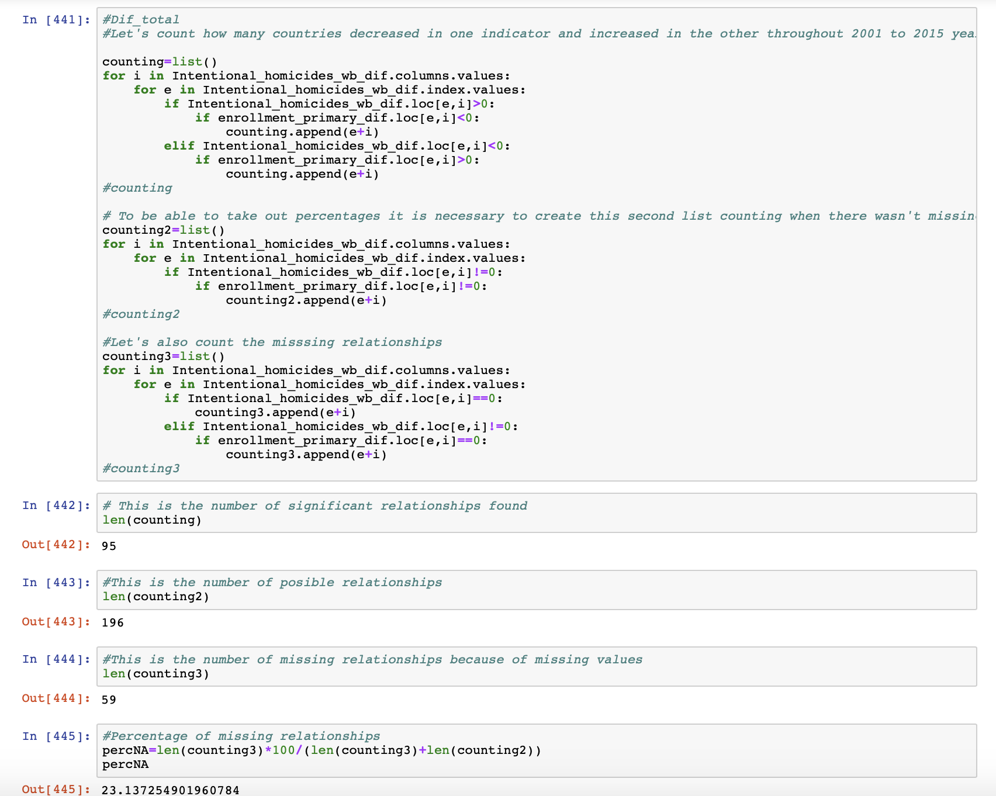
Code - Overview
Overview
Homicides vs. Enrollment
Homicides vs. PISA scores
Conclusions

Slide 11
Intentional Homicides vs. PISA scores
Reduced countries (Uruguay, Chile, Brazil, Colombia, Mexico, Costa Rica, Canada, United States)
Less years (2006-2009-2012-2015)
Variations
Meaningful relationships:
Science 50%
Math 59%
Reading 63%
Overview
Homicides vs. Enrollment
Homicides vs. PISA scores
Conclusions

Slide 12
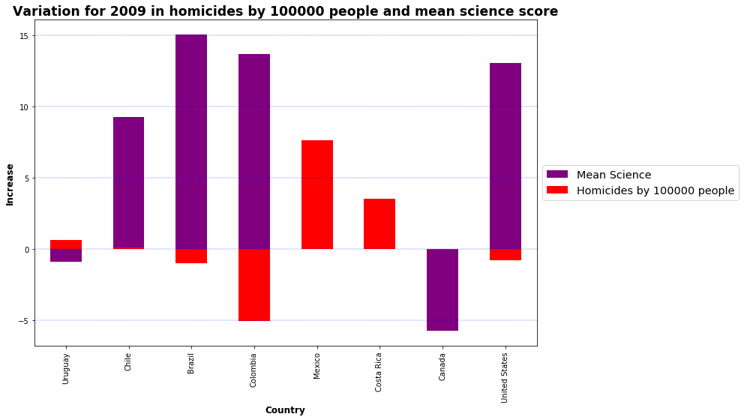
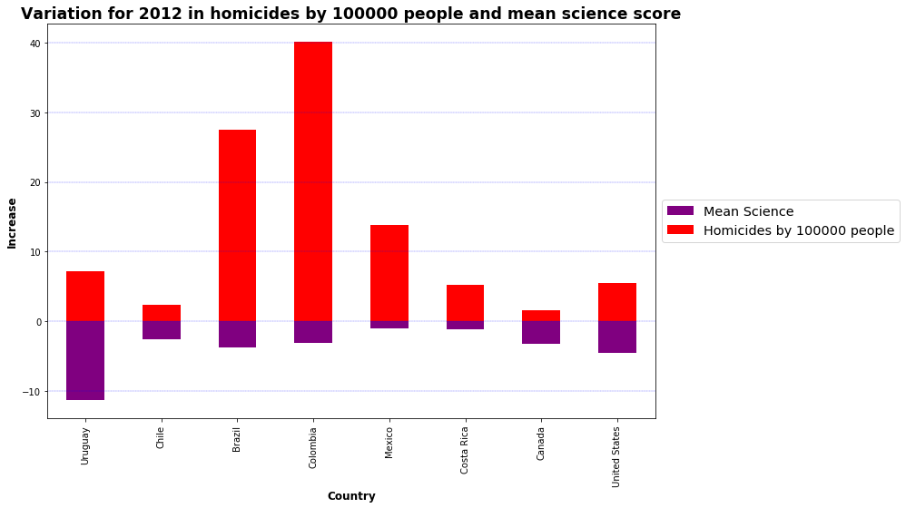
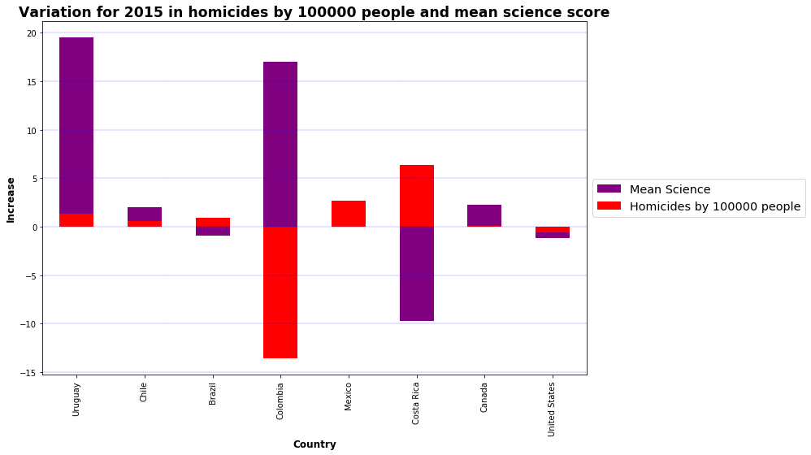
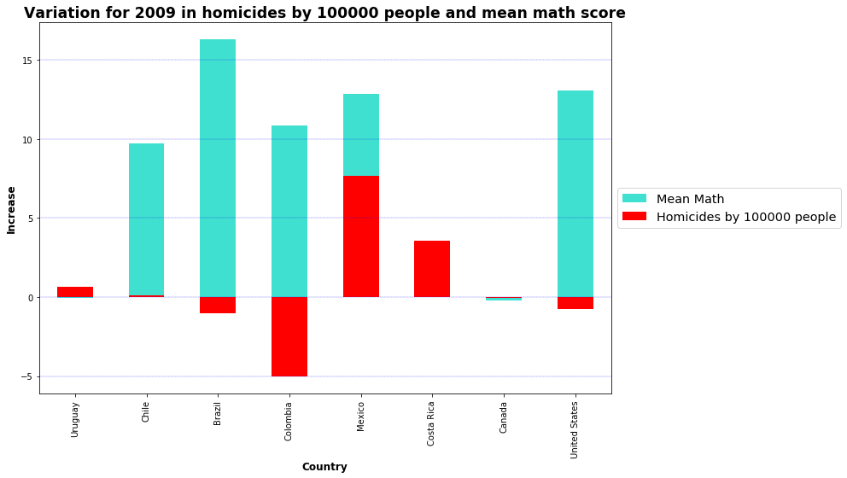
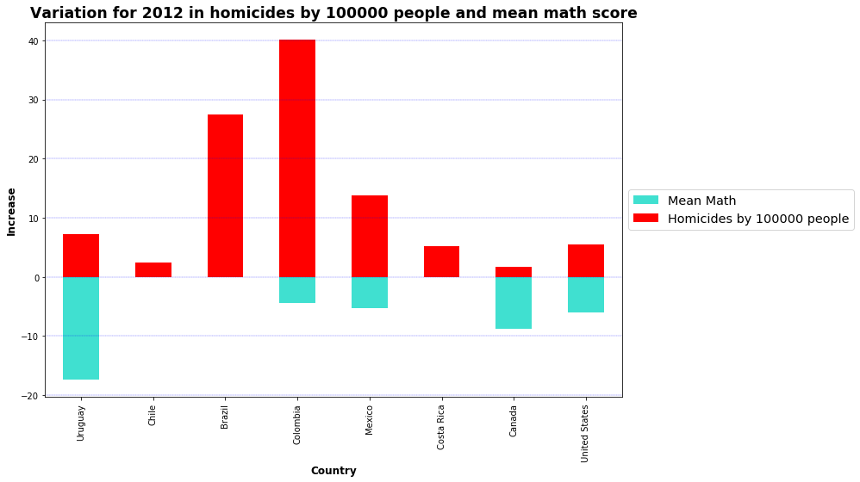
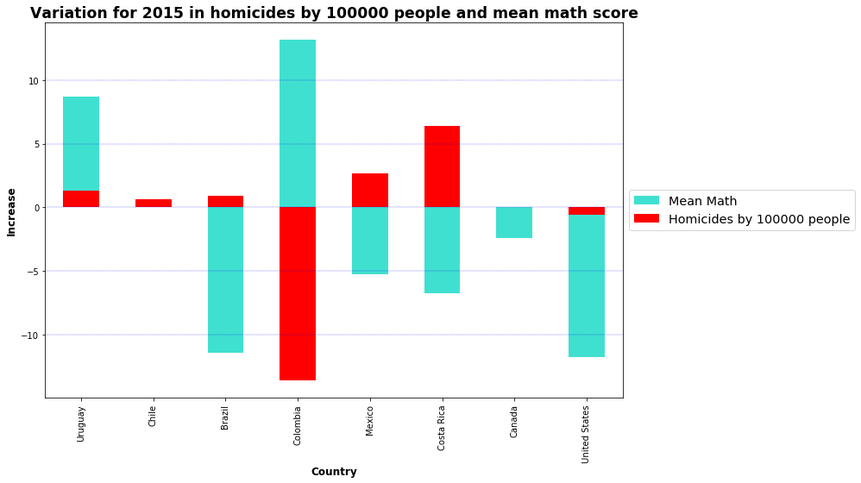
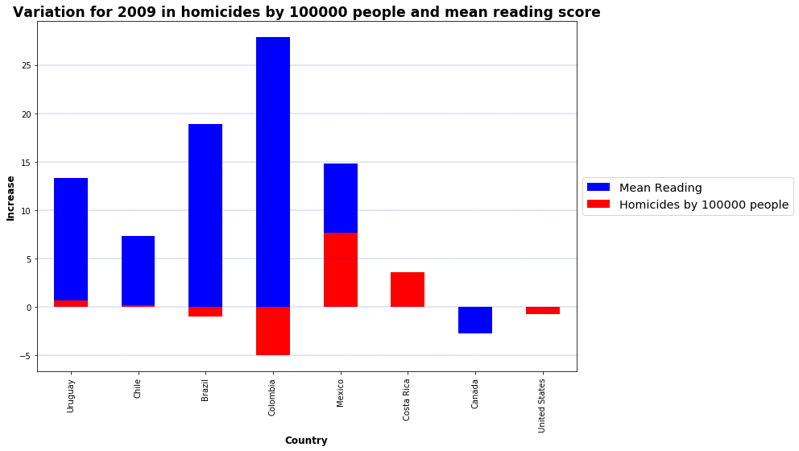
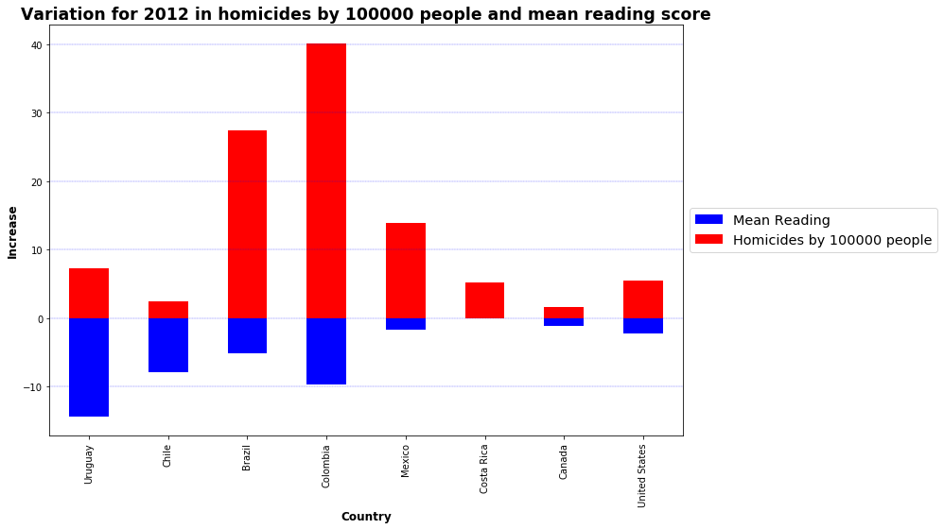
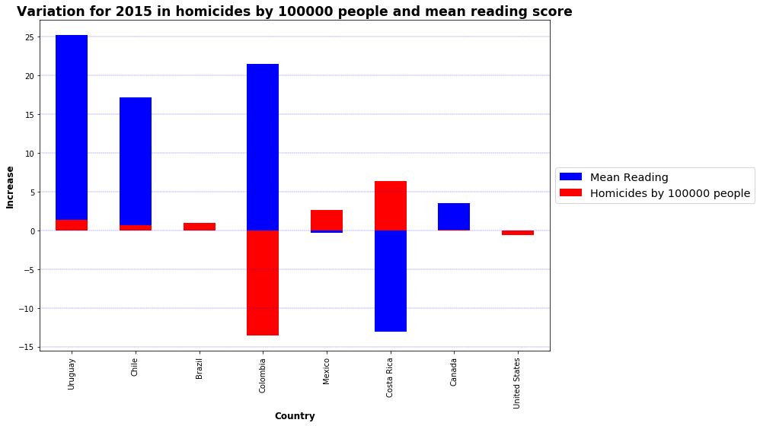
Variations Intentional homicides vs. PISA scores
Science
Math
Reading
Overview
Homicides vs. Enrollment
Homicides vs. PISA scores
Conclusions

Slide 13
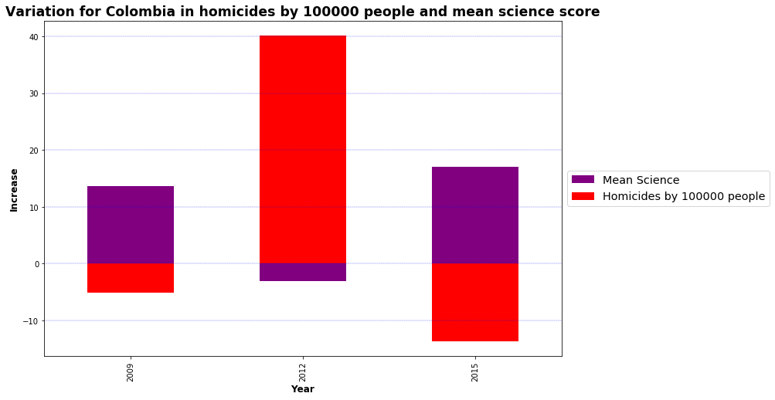
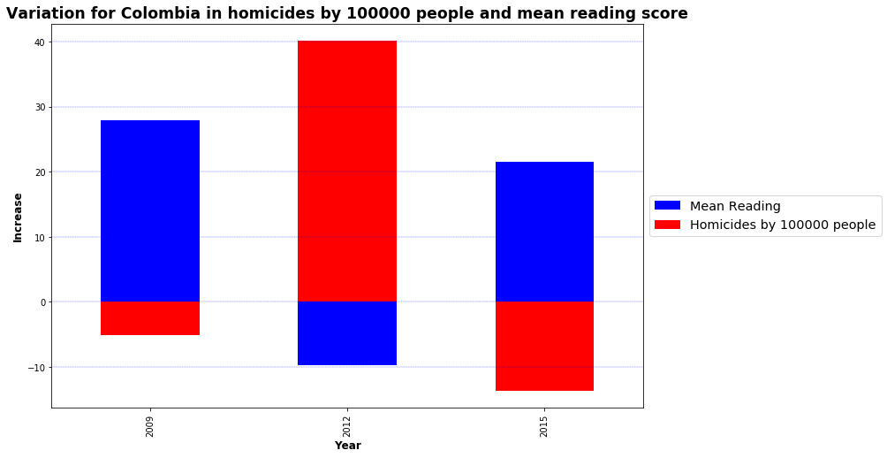
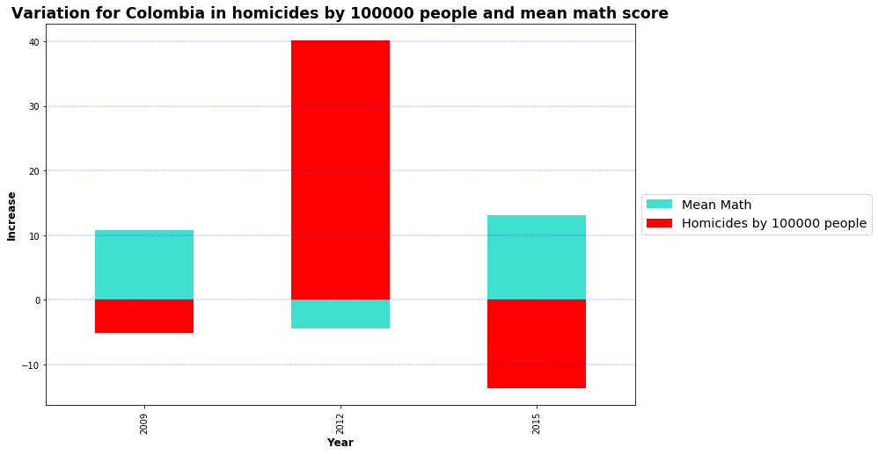
Intentional homicides vs. PISA scores - Colombia
Overview
Homicides vs. Enrollment
Homicides vs. PISA scores
Conclusions

Slide 14
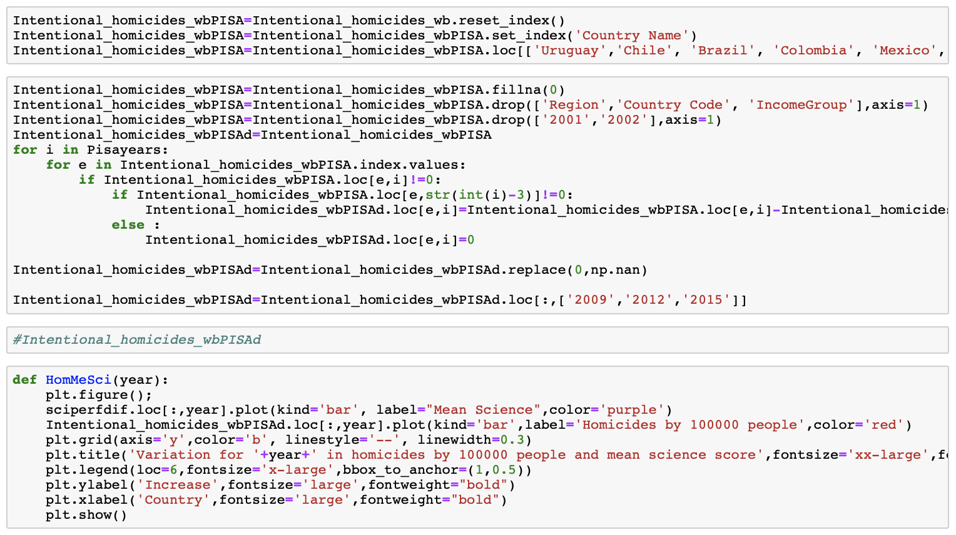
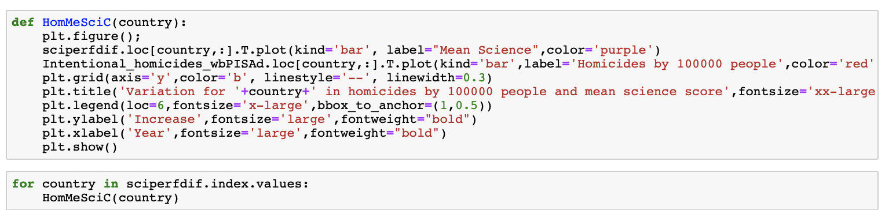
Code - Overview
Overview
Homicides vs. Enrollment
Homicides vs. PISA scores
Conclusions

Slide 15
Conclusions and recommendations
Cleaning data frames takes time and is better to make a draft of what you need and how to get it
48% meaningful relationships Intentional homicides and primary enrollment
North America 50%, Central America 42%, South America 55%
Canada, Chile, Colombia, Panama, El Salvador
Science 50%, Math 58%, Reading 63%
Inspect other regions
Inspect with more data/ indicators
Overview
Homicides vs. Enrollment
Homicides vs. PISA scores
Conclusions

